Slide 1


Introduction to Competitive Programming
Week 5: Greedy + Brute Force
Notes:
https://join.slack.com/t/introductiont-c5a2137/shared_invite/zt-djtdwpqu-S_tju9SZhk2IKhcYICitCQ

Slide 2

Be greedy
Make locally optimal choices

Slide 3
1.
Warm-ups

Slide 4
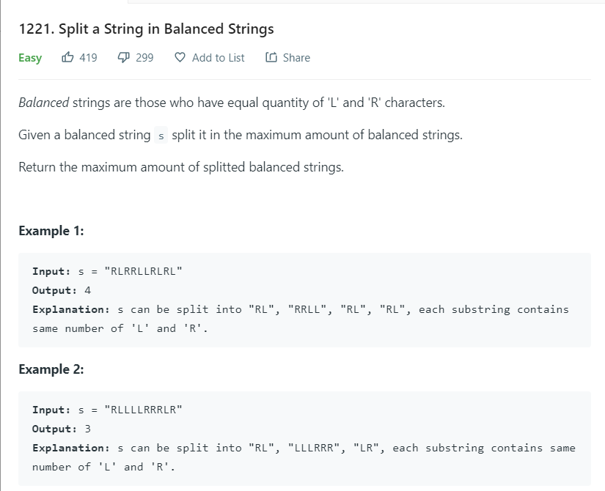
Warm-up 1

Slide 5
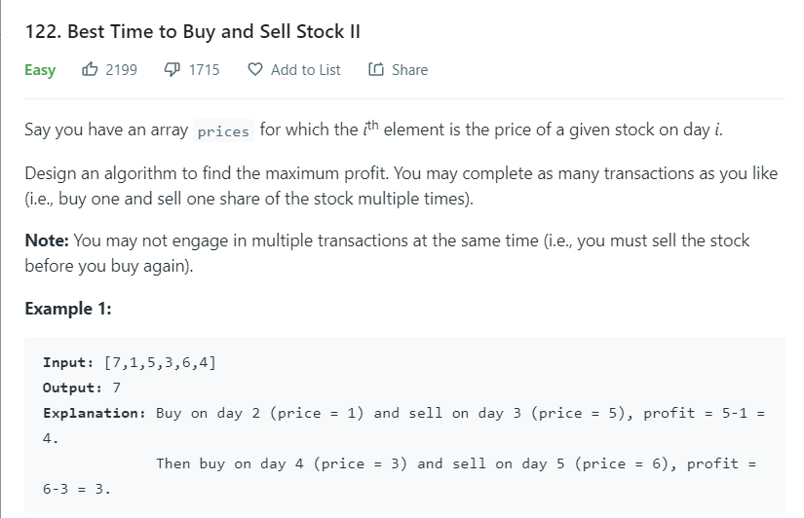
Warm-up 2*

Slide 6
2.
Using Sorting

Slide 7
General Techniques
Working with unsorted data is tough!
Numbers can be all over the place
Price of houses (unsorted): [234, 176, 740, 199, 400, 867]
Price of houses (sorted): [176, 199, 234, 400, 740, 867]
Sort the data!
Pair with techniques like…
Binary search (necessary condition, dictionary)
Two pointers (when you have two sorted lists)
HW
In class

Slide 8
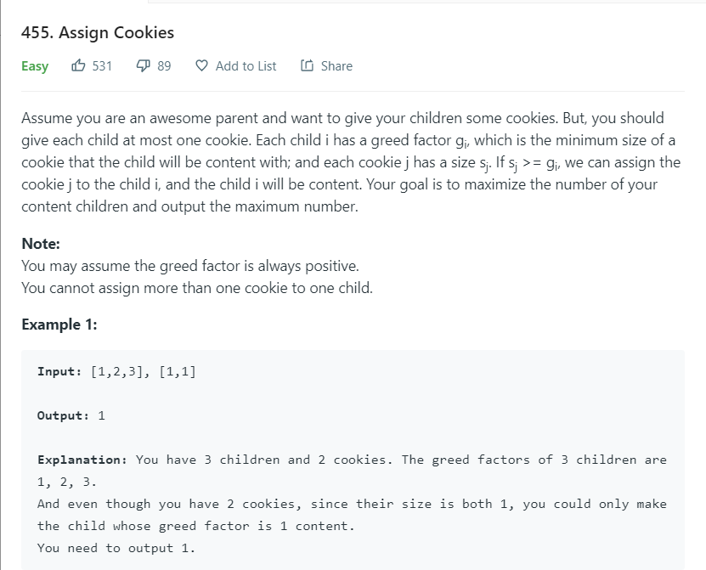
Cookies (again)*

Slide 9
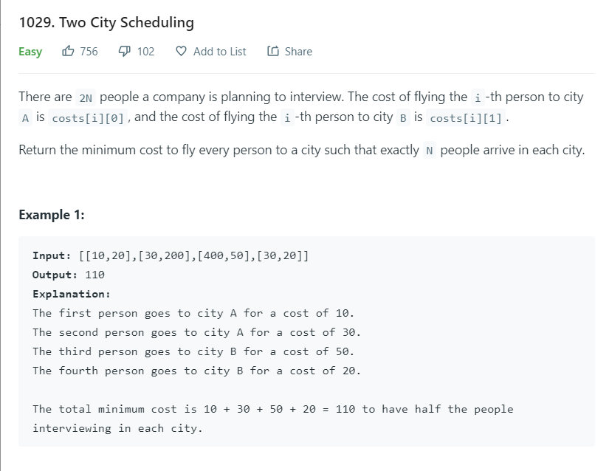
Scheduling (real-world problem)*

Slide 10
3.
Brute Force

Slide 11
General Techniques
When you don’t have anything smart to do...
Do something stupid! - Richard Rusczyk
But not too stupid...
Brute force (meaning just do what the problem tells you / try everything)
Pair with techniques like…
Data Structures (priority queue, map etc.)

Slide 12
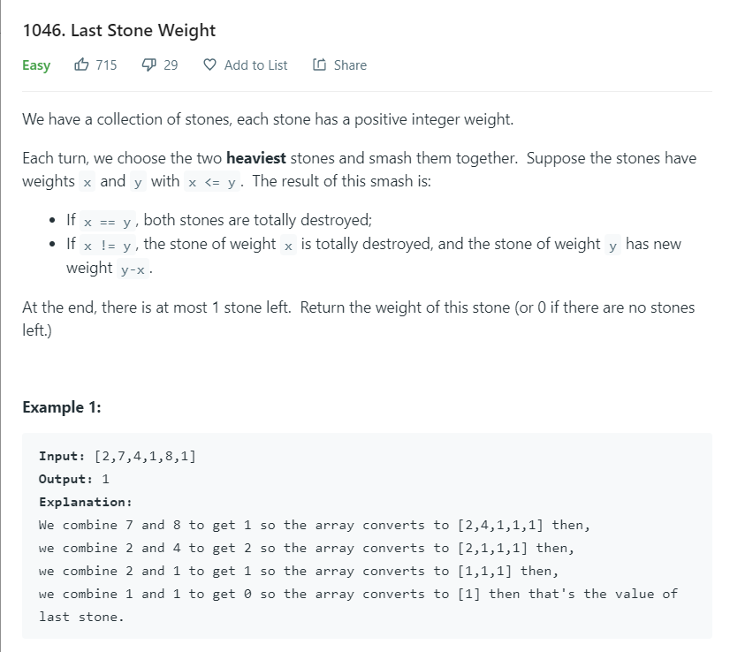
Bash*

Slide 13
4.
Endnotes

Slide 14
Homework
Week 5: Greedy, Brute Force
Collected
Bug fixing, optimization
Watch Python tutorial
Highly encouraged
4-5 / week
Leetcode

Slide 15
5.
Q & A, Homework Review, Python Help

